Slide 2
DevOps for Ops - Automate All the Things!

Slide 3
Agenda
What is DevOps?
But what about Ops?
Tools
Demo
Release Pipeline

Slide 4
What is DevOps?
Culture and processes
Not about tools and technology, although this is a critical part
In the past: Operators vs Developers
DevOps makes it Operators and Developers
New technologies such as containers and Nano Server makes DevOps even more important

Slide 5
But what about Ops?
Operations will need to adjust to common developer practices
Infrastructure as Code
Tooling
Source control
Test tools
Build tools
Continious Delivery
Continous Integration
Automation

Slide 6
Tools
Source Control (git/GitHub)
Testing (Pester)
Build/Deploy CI (AppVeyor)
Distribution (nuget / MyGet/PowerShellGet)

Slide 7
Demo time!
Notes:
ØK: Git-demo
JER: PowerShellGet
JER: Pester
ØK: AppVeyor (1. pause)

Slide 8
Workflow
Development
Git
Test/Deployment
AppVeyor
Distribution
NuGet
Pester
PSScriptAnalyzer

Slide 9
Notes:
Scenario:
Operator performs basic task using a command the internal PowerShell module (create a new virtual machine)
Operator finds it cumbersome to manage workgroup joined machines, and wants a new feature in the New-NanoVM command: Join the machine to the domain
Developer gets notified of a new feature request from GitHub and needs to add new functionality to the New-NanoVM command.

Slide 10
Back to demo

Slide 11
Automated release pipeline
Tend to be more streamlined and contains less manual work
Faster
More robust and reliable
Easier to track changes (source control)
Because Automation! Wouldn’t you rather be doing something else?
Notes:
ØK

Slide 12
Automated release pipeline showcase Azure Automation
End user triggers runbook to order a new Nano VM
For example via a webhook triggered by a frontend portal
Runbook leverages Update-Module to get latest version of module
Unit tests of module already run in AppVeyor
Operational Validation tests executes first
Verify that SC VMM is available
Verify that Hyper-V hosts is healthy
Verify that Active Directory is available
Code that triggers New-NanoVM runs if all tests passes
Notes:
An example scenario in addition to an operator using the module interactively is using it from a runbook in Azure Automation

Slide 13
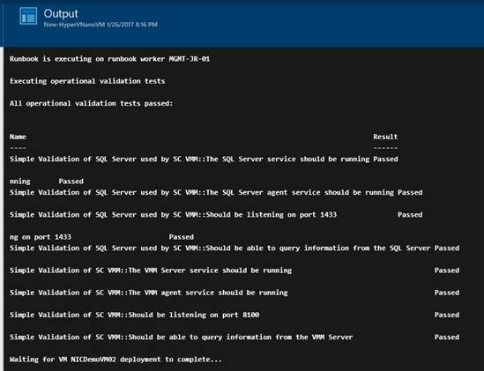
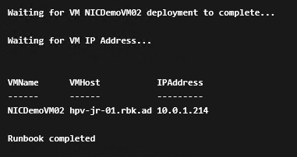
Azure Automation runbook example

Slide 14
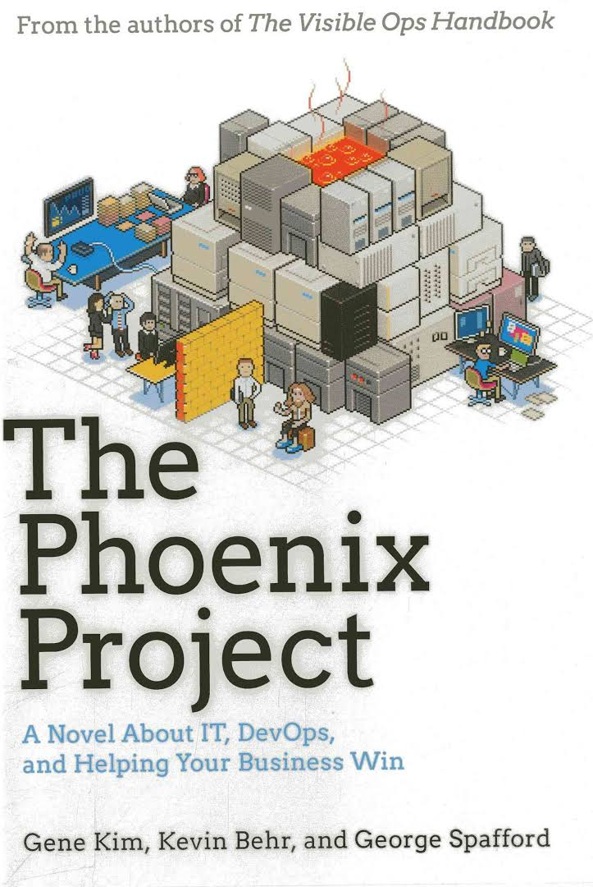
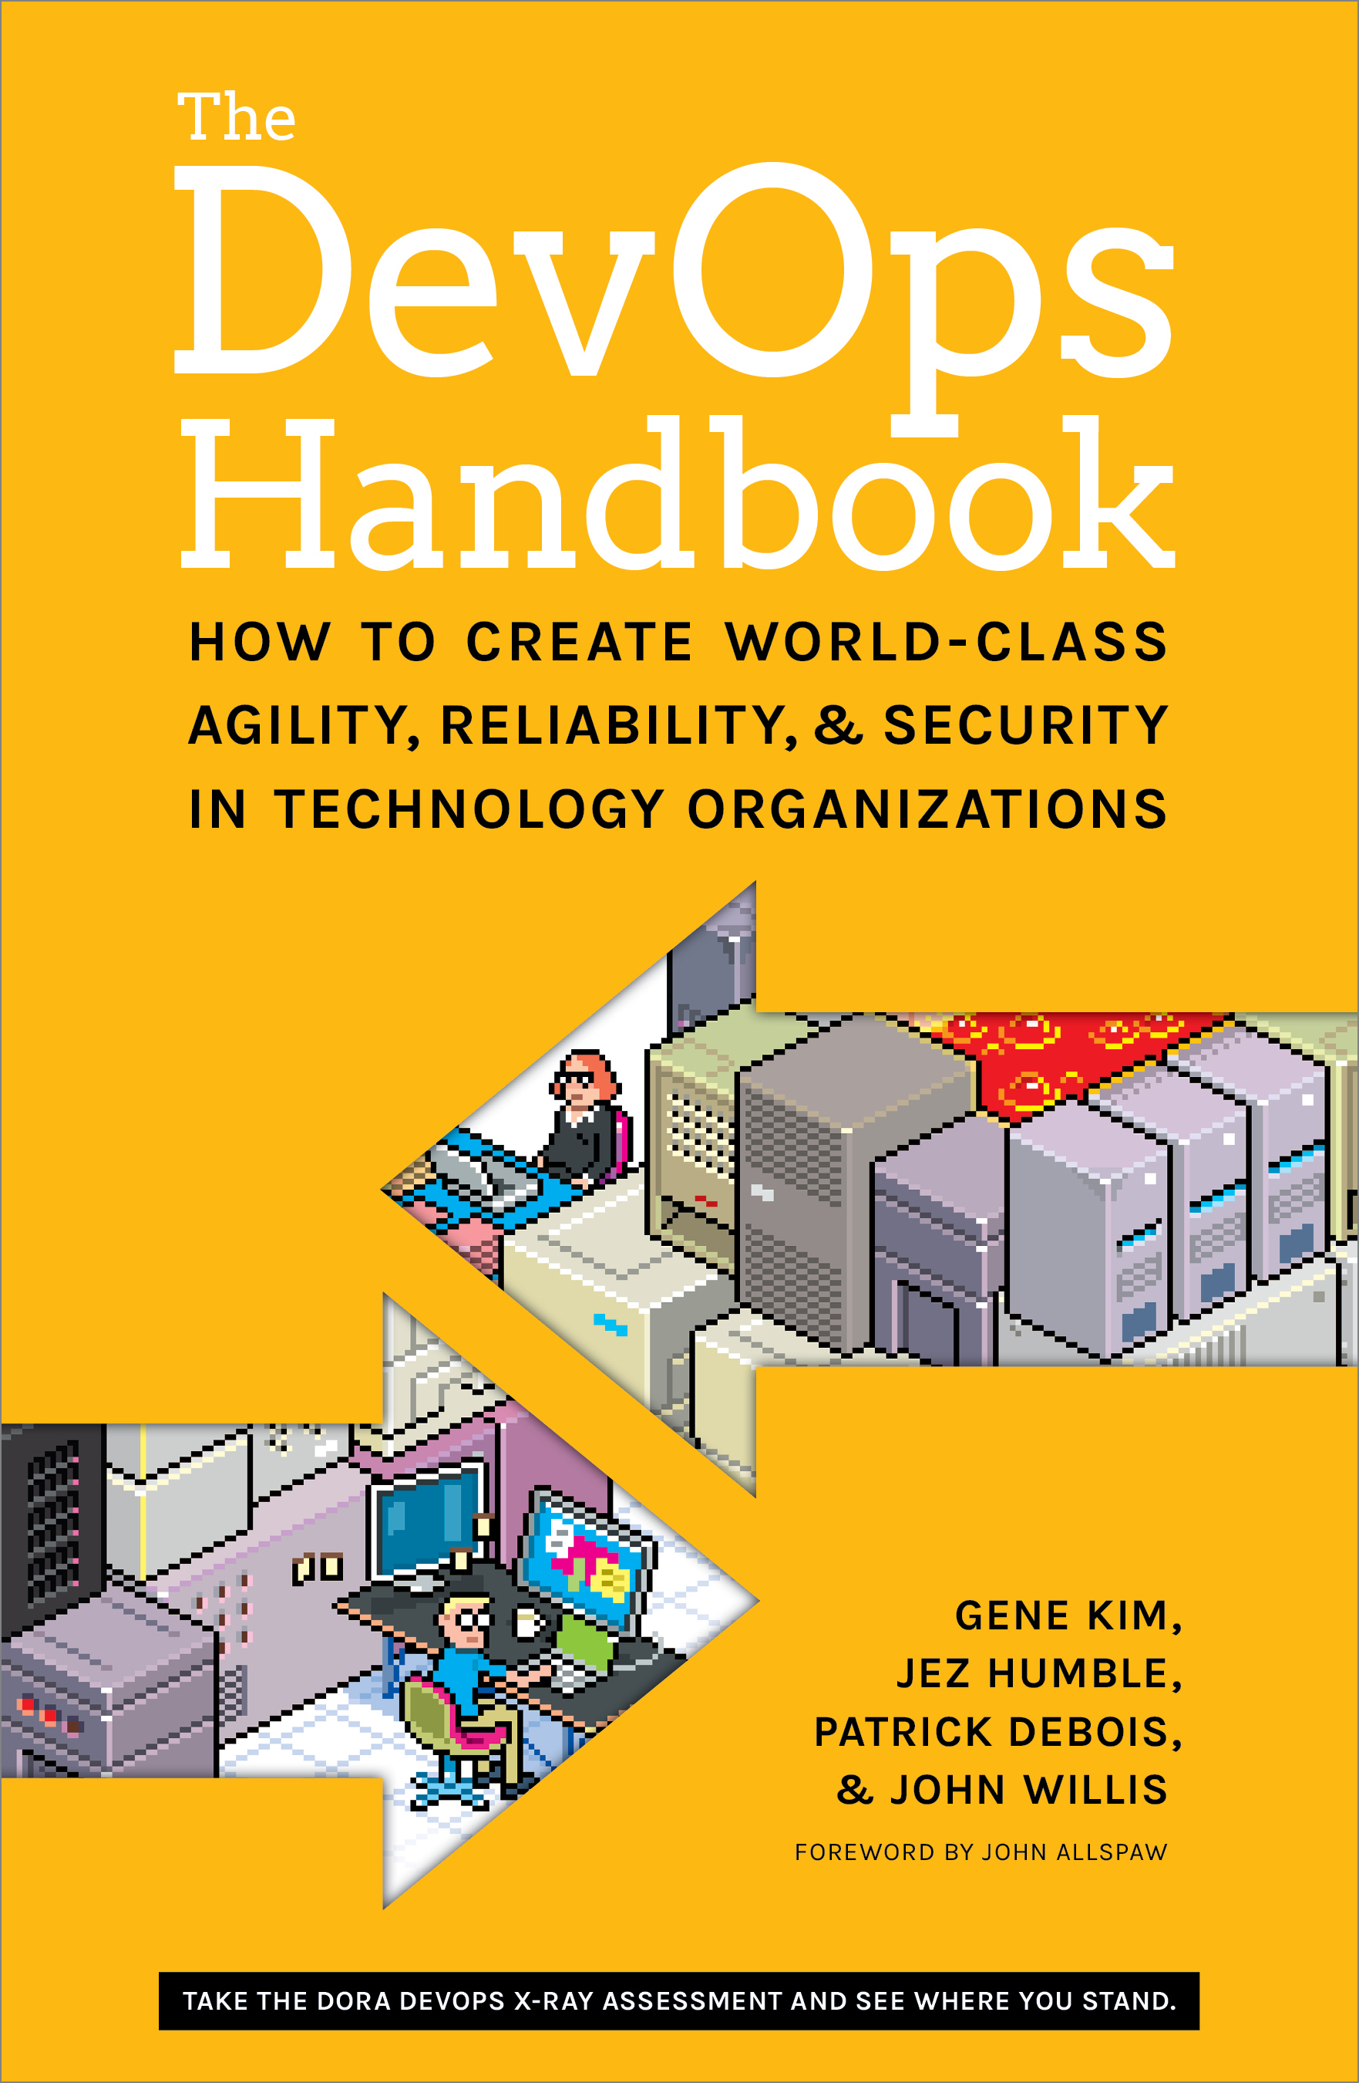
Resources
Whitepaper: The Release Pipeline Model
https://msdn.microsoft.com/en-us/powershell/dsc/whitepapers
Books: The Phoenix Project, The DevOps Handbook
More: http://stevenmurawski.com/devops-reading-list/

Slide 15
About us
Øyvind Kallstad
Senior Consultant at Crayon
oyvind.kallstad@crayon.com
@OKallstad
Jan Egil Ring
Lead Architect, Infrastructure at Crayon
jan.egil.ring@crayon.com
@JanEgilRing

Slide 16
Thank you!

